Slide 1
UNIT I
FOUNDATIONS OF INCIDENT RESPONSE MANAGEMENT
Anouska Dutta Lecturer
National Forensic Sciences University

Slide 2
KEY CONCEPTS OF INFORMATION SECURITY DATA CLASSIFICATION
CYBER INCIDENT STATISTICS AND TRENDS
SECURITY INCIDENT VS. A SECURITY EVENT VS. A SECURITY ALERT TYPES OF COMPUTER SECURITY INCIDENTS
CYBER THREAT LANDSCAPE AND INCIDENT STATISTICS SIGNS OF AN INCIDENT: PRECURSORS AND INDICATORS MAJOR CATEGORIES OF INCIDENTS
NEED & GOALS OF INCIDENT RESPONSE MAJOR CHALLENGES IN INCIDENT RESPONSE

Slide 3
WHAT IS
INFORMATION SECURITY ?
Information security, or InfoSec, is the practice of protecting both physical and digital data from unauthorized access, use, disclosure, disruption, modification, or destruction. Its main goal is to reduce risks and keep valuable information safe.
Information security (InfoSec) is the protection of important
against unauthorized access, disclosure, use,
information
alteration or disruption.
It helps ensure that sensitive
organizational data is available to authorized users, remains confidential and maintains its integrity.

Slide 4
WHY INFORMATION SECURITY EXSITS?
Protects the confidentiality, integrity, and availability of data.
Prevent operational disruptions and maintain seamless day-to-day business functions. Meet compliance, regulatory, and legal obligations for safeguarding sensitive information.
Maintain customer trust and brand reputation by avoiding exposure of sensitive information.
Safeguard intellectual property to maintain profitability and competitive advantage.
Align IT and cybersecurity strategies with overall business goals.

Slide 5
THE BENEFITS OF INFOSEC
Regulatory compliance: Organizations can meet standards like HIPAA or PCI-DSS, reducing legal risks and avoiding costly fines.
Cost savings: A tiered security approach ensures complete protection for each data type without overspending on low-risk assets.
Operational efficiency: Clear processes and data classification enable employees to manage information effectively and securely.
Reputation protection: It helps maintain public trust and customer loyalty by preventing damaging security incidents.
Risk reduction: Prepared systems and response plans lower the likelihood and impact of cyberattacks or data breaches.
Data integrity: Accurate and secure information is preserved against unauthorized changes, corruption, or theft.

Slide 6
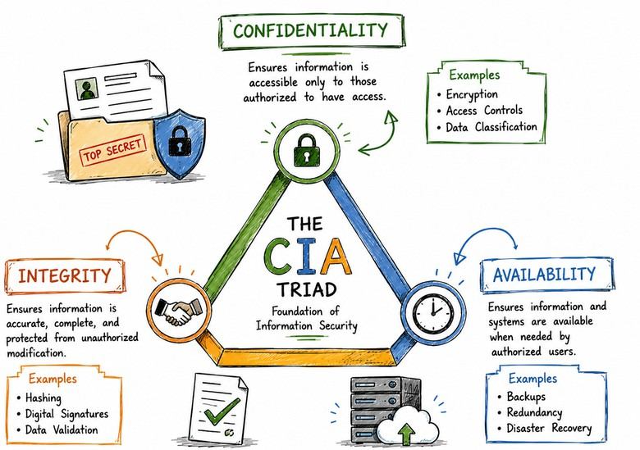
KEY PRINCIPLES OF INFORMATION SECURITY
C-I-A TRAID
Information security is necessary to ensure the confidentiality, integrity, and availability of information, whether it is stored digitally or in other forms such as paper documents. Information Security programs are build around 3 objectives, commonly known as -
CIA - Confidentiality, Integrity, Availability.

Slide 7
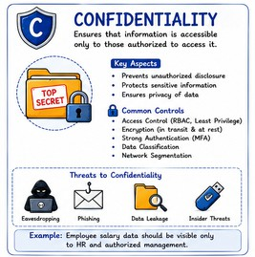
Confidentiality
Means information is not disclosed to unauthorized individuals, entities and process. For example if we say I have a password for my Gmail account but someone saw while I was doing a login into Gmail account. In that case my password has been compromised and Confidentiality has been breached.
Confidentiality means ensuring that parties cannot access data they're not authorized to access.
Confidentiality defines a continuum of users, from privileged insiders with access to much of the company's data to outsiders authorized to view only information the public is permitted to view.
Personal information should remain private. Sensitive data is sensitive. If an unauthorized person obtains a password to protected data, it would be a confidentiality breach.

Slide 8
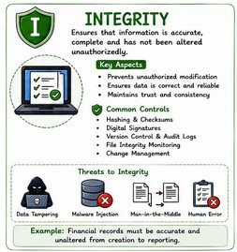
Integrity
Means
maintaining accuracy and completeness of
data. This means data cannot be edited in an unauthorized way. For example if an employee leaves an organisation then in that case data for that employee in all departments like accounts, should be updated to reflect status to JOB LEFT so that data is complete and accurate and in addition to this only authorized person should be allowed to edit employee data.
Integrity means ensuring that all information contained within company databases is complete and accurate.
Integrity efforts aim to stop people from tampering with data, such as by unauthorized additions, alterations or deletions. Data integrity applies to preventing both adversaries who intentionally alter data and well-intentioned users who alter data in unauthorized ways.

Slide 9
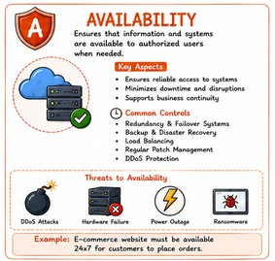
Availability
Means information must be available when needed. For example if one needs to access information of a particular employee to check whether employee has outstanded the number of leaves, in that case it requires collaboration from different organizational teams like network operations, development operations, incident response and policy/change management. Denial of service attack is one of the factor that can hamper the availability of information.
Availability means ensuring that users can access the information they're authorized to access when they need it.
Availability dictates that information security measures and policies should not interfere with authorized data access. Much of availability is straightforward, such as working to ensure the robustness of hardware and software to prevent an organization’s sites going down.

Slide 10
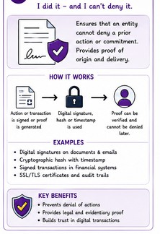
Non repudiation
Means one party cannot deny receiving a message or a transaction nor can the other party deny sending a message or a transaction. For example in cryptography it is sufficient to show that message matches the digital signature signed with sender's private key and that sender could have a sent a message and nobody else could have altered it in transit. Data Integrity and Authenticity are pre-requisites for Non repudiation.
Nonrepudiation means that a user cannot deny (that is, repudiate) having made a transaction such as altering data or sending a message because the user needed to pass authentication to perform the transaction in the first place.
While not technically part of the CIA triad, nonrepudiation does combine aspects of information confidentiality and integrity. Nonrepudiation involves ensuring that only authorized users work with data, and that they can only use or modify data in authorized ways.

Slide 11
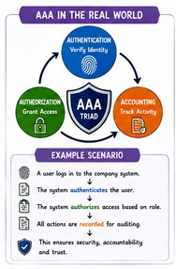
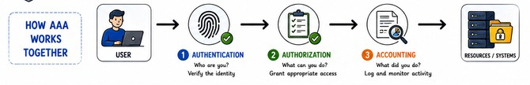
AAA
In information security, AAA stands for Authentication, Authorization, and Accounting. It is a foundational framework used to control who is allowed to access network resources, what permissions they have while inside, and to track their activities.
Authentication: Verifies the identity of a user or device, typically via passwords, tokens, or biometrics. It answers the question, "Who are you?"
Authorization:
Determines which resources, files, or actions the
authenticated user is permitted to access or perform (e.g., read-only vs. admin privileges). It answers the question, "What are you allowed to do?"
Accounting: Tracks and logs user activity, such as login/logout times and data consumed. It answers the question, "What did you do?"

Slide 12
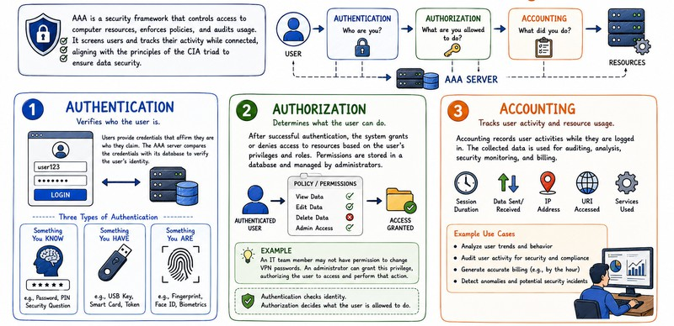

Slide 13
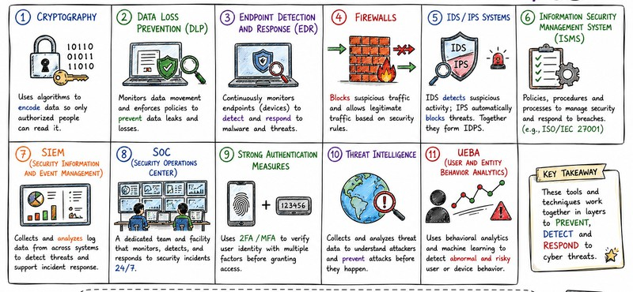
INFOSEC TOOLS & TECHNIQUES

Slide 14
DATA CLASSIFICATION
Data classification is the process of organizing digital files and records into categories based on their sensitivity, business value, and risk level. This practice helps organizations apply proper security controls, comply with legal privacy standards, and manage information efficiently without over-securing routine files.
Data classification in incident response is the process of sorting compromised or exposed information by sensitivity levels. It helps security teams quickly find critical assets, judge breach impact, prioritize containment steps, and fulfill legal reporting rules.
It also helps the Incident Response (IR) team decide which incidents need immediate attention, what protection is required, and who should be notified.

Slide 15
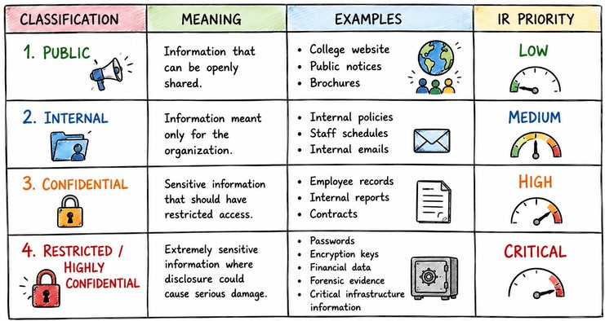
by sensitivity, value, and regulatory needs. This allows
Data classification organizes data
organizations to protect sensitive data, meet compliance standards, and improve data governance for easier access and use.
Data classification eases the processes involved in finding and retrieving data, securing data, optimizing data-based processes, and maintaining compliance. Data classification is based on the organization of data according to specific categories so that users and applications can make more efficient use of it.
DATA CLASSIFICATION
LEVELS

Slide 16
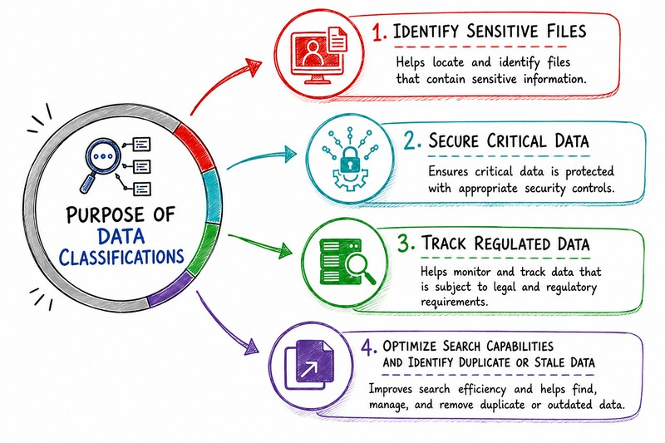

Slide 17
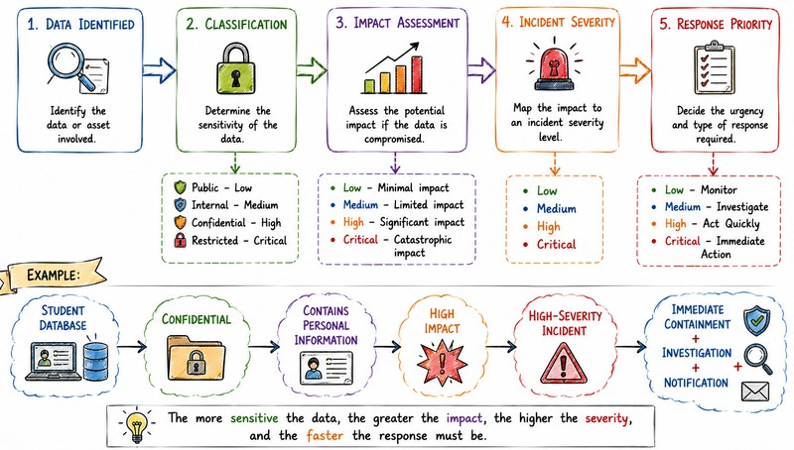
DATA CLASSIFICATION → INCIDENT SEVERITY

Slide 18
CYBER INCIDENT STATISTICS AND TRENDS
UNFI (United Natural Foods Inc.) food-supply disruption: This cyber attack occurred in mid-June 2025 and impacted electronic ordering and delivery systems for a major U.S. grocery wholesaler. It led to measurable grocery shortages and forced retailers to find alternate suppliers. The incident highlights the fragility of digital supply chains.
Bank Sepah massive data theft: This breach occurred in March 2025 and was carried out by the “Codebreakers” collective. It exposed a million customer records and involved extortion attempts of $42 million. The attack was one of 2025’s largest financial-sector compromises, reflecting serious risks to banking data and confidence.
Marks & Spencer (M&S) retail outage from social engineering: The Easter-weekend compromise conducted by Scattered Spider disabled online shopping. It led to multi-week retail disruption. It caused losses of up to £300m. This attack shows the cascading business impact of targeted social engineering.
SAP NetWeaver zero-day (CVE-2025-31324) enterprise software exploitation: This incident occurred in April and involved the disclosure of a critical RCE vulnerability. It allowed web-shell uploads and active exploitation across hundreds of instances. The incident is proof of how a single flaw can put cloud and public-sector infrastructure at risk.
Kettering Health (Interlock ransomware) healthcare disruption: This incident happened in June 2025. The ransomware attack disrupted internal systems, phone lines, and EHRs across 14 medical centers. This led to forced procedure cancellations and ambulance diversions. It’s clear that healthcare remains a high-impact target with direct public-safety consequences.

Slide 19
U.S. Treasury vendor breach: The incident took place in December 2024. Chinese hackers accessed a third-party contractor that provided IT services to the U.S. Treasury. It is reported that around 3,000 unclassified documents linked to senior officials and financial oversight offices were exposed. The breach highlighted serious risks in government supply-chain security.
North Korean crypto exchange hacks: North Korean hackers stole millions of dollars from crypto platforms in January 2024. The funds were moved through mixing services. The stolen funds were laundered through crypto mixing services to hide their origin. This activity helped finance North Korea’s weapons programs and impacted trust in cryptocurrency platforms.
Romania election cyber targeting: The attack occurred in December 2024, ahead of Romania’s presidential election. The Russian hackers launched more than 85,000 attacks against election-related systems. The credentials they stole were later leaked on Russian hacker forums. This activity threatened election integrity and public confidence.
Salt Typhoon global telecom espionage: Chinese hackers infiltrated telecom providers in the U.S. and more than twenty other countries. They gain unauthorized access to call data, surveillance requests, and private communications. The breach enabled long-term intelligence collection on political figures. The campaign was revealed publicly in November 2024.

Slide 20
FINTRAC cyber incident: The incident happened in March 2024, and Canada had to shut down its financial intelligence system. The attacker remains unidentified, but the anti-money laundering operations were disrupted. This shutdown temporarily limited the government’s ability to monitor and investigate financial crime.
Pro-Russian cyberattacks on South Korea: The attacks followed political developments in November 2024. South Korean government and civilian websites were targeted by hackers, and several pro-Russian groups claimed responsibility. The attacks aimed to pressure South Korea over Ukraine-related decisions.
Iranian hack of Israeli Nuclear IT: Iranian hackers breached a connected IT network. They leaked sensitive documents online. This incident took place in March 2024. The operational systems remained secure, but the incident heightened regional security and geopolitical tensions.
Chinese breaches of Canadian government networks: Chinese hackers accessed at least twenty Canadian government systems. This activity was confirmed in October 2024. The operations involved espionage and political surveillance. Canada raised concerns over national security risks.
Trump and Harris campaign phone hack: Chinese hackers accessed phones used by senior U.S. political figures in October 2024. The FBI launched an investigation into the incident, but it raised election security concerns.

Slide 21
Ukraine power grid cyber probing: This cyber activity was detected in December
MAJOR GLOBAL CYBER ATTACKS
2023. The Russian hackers scanned Ukrainian energy networks. No blackout occurred,
but access attempts increased sharply. The probing signaled preparation for future attacks.
Russian cyberattacks on Baltic States: The Russian hackers targeted government portals in Estonia and Latvia in November 2023. As a result, services experienced temporary outages. The attacks were politically motivated.
Chinese surveillance of Southeast Asian governments: The campaign was revealed in October 2023 and conducted by Chinese hackers. They infiltrated government networks across Southeast Asia and gained long-term access. This allowed the attackers to monitor data. The operation focused on regional political intelligence.
Iranian hack of Albanian government: Reports state that Iranian hackers disrupted Albanian government digital services because of public systems being taken offline for days. The incident was reported in October 2023 and followed diplomatic tensions.
Ransomware attack on Sri Lankan government: Hackers gained unauthorized access and deleted months of government cloud data in September 2023. Their backup systems failed to restore information, and public services suffered long-term disruption.

Slide 22
Russian hijacking of Pakistani hacker infrastructure: Russian hackers secretly took control of systems used by a Pakistani hacking group in December 2024. They viewed sensitive data stolen from South Asian government and military targets. The case showed how state actors exploit other cybercriminal groups for intelligence.
Phishing campaign against Ukrainian armed forces: Russian attackers sent phishing messages to Ukrainian military personnel and defense companies in December 2024. They used malware tools to steal credentials from messaging platforms and internal systems. The effort risked exposing sensitive military operations.
Fake cloud emails targeting Ukraine: This campaign took place in October 2024. Russian hackers sent emails disguised as Amazon and Microsoft messages to users. They stole credentials from Ukrainian military and government users. This increased the risk of unauthorized access to sensitive systems and operations.
Kazakhstan diplomatic spearphishing attack: In January 2025, suspected Russian-linked hackers launched phishing attacks against Kazakhstan’s diplomatic institutions. The hackers embedded malicious code inside fake official-looking diplomatic documents. Their goal was cyber espionage, focusing on sensitive foreign policy communications.
Moroccan social security data leak: Hackers linked to Algeria breached Morocco’s National Social Security Fund in April 2025. The hackers leaked personal and financial information of around two million customers.

Slide 23
North Korean cryptocurrency theft: North Korean hackers carried out the largest cryptocurrency theft ever in February 2025. They exploited a vulnerability in third-party wallet software to steal around $1.5 billion worth of Ethereum from the ByBit exchange.
Fake recruitment targeting U.S. federal workers: Front companies linked to a Chinese tech firm targeted recently laid-off U.S. federal employees in March 2025. The operation used fake job advertisements to initiate contact. Authorities warned the campaign resembled foreign intelligence recruitment tactics.
OCC email surveillance breach: In April 2025, it was disclosed that hackers had secretly monitored emails from over 100 U.S. bank regulators. The attackers used a compromised administrator account to conduct the act. The exposed emails had several sensitive details about regulated financial institutions.
Microsoft SharePoint exploitation: China-linked
attackers exploited critical vulnerabilities in
Microsoft SharePoint software in July 2025. This incident impacted U.S. government agencies and international companies.
Heathrow and European airport disruption: Hackers launched a ransomware attack and impacted airport operations platforms used across Europe in September 2025. Several functions, like check-in and boarding systems at major airports, including Heathrow, were shut down. The airlines had to carry out the functions manually.

Slide 24
BIGGEST DATA BREACHES
SAP SE Bulgaria: SAP SE was impacted after Kubernetes Secrets were found exposed in public GitHub repositories in November 2023. It granted access to over 95 million artefacts. The exposed data included credentials and deployment permissions related to hundreds of organizations. SAP quickly remediated the issue. However, the incident showed how leaked secrets can enable large-scale supply-chain exposure.
TmaxSoft: South Korean IT firm TmaxSoft leaked over 56 million sensitive records in November 2023. The data included employee contact details, internal emails, and contract information, and remained exposed for two years. Such exposure increased the risk of phishing and supply-chain attacks.
Indian Council of Medical Research (ICMR): Data of around 815 million Indian citizens in October 2023. It was reportedly stolen from a COVID-testing database and offered for sale on the dark web. Exposed details included Aadhaar numbers, passport numbers, and home addresses. The breach represented one of the largest health data exposures ever recorded.
23andMe: Consumer genetics company 23andMe suffered credential-stuffing attacks that exposed data from up to 20 million profiles in October 2023. The stolen information included genetic ancestry data, with specific targeting of Ashkenazi Jewish users. The incident underscored the risks of password reuse and weak authentication controls.

Slide 25
Palau government breach: In June 2024, Palau’s government reported a breach that led to theft of more than 20,000 official documents. The breach happened soon after Palau finalized a long-term economic and security agreement with the U.S. The incident was considered the country’s first large-scale compromise of government records.
Snowflake: Cloud data platform Snowflake suffered a major breach in May 2024. It impacted over 100 customer organizations, including AT&T, Ticketmaster, and Santander Bank. Hackers linked to the Scattered Spider group gained unauthorized access by exploiting compromised employee credentials. They stole information, including billions of AT&T call records and personal data from Ticketmaster and Santander customers. The attackers demanded ransoms ranging from $300,000 to $5 million.
UK Ministry of Defence: The UK Ministry of Defence suffered a data breach in May 2024 after a cyberattack compromised a payroll system. The attackers misused personal and financial information of around 270,000 current and former military personnel. The data exposed names, bank details, and some home addresses. The breach highlighted serious supply-chain security risks.
The North Face: The North Face suffered a credential-stuffing attack in June 2025. The breach exposed nearly 3,000 customer accounts. Attackers accessed personal details, such as names, addresses, and purchase history. The incident was linked to the Scattered Spider cybercrime group and highlighted ongoing risks facing retail brands from reused credentials.

Slide 26
Cartier: Luxury brand Cartier disclosed a data breach in June 2025. The hackers gained access to limited customer information. While the company said financial data was not affected, the breach added to a growing list of cyber incidents targeting high-end fashion brands. The attack was also associated with activity linked to Scattered Spider.
Illinois State agencies: Hackers compromised a TxDOT account and downloaded nearly 300,000 crash reports in June 2025. The data had personal and licensing data. At the same time, a phishing campaign against Illinois Health and Family Services employees exposed sensitive data of 933 individuals. The attacks demonstrated how weak account security can impact public-sector systems.
Zoomcar: Indian car-sharing company Zoomcar reported a data breach in June 2025. It impacted nearly 8.4 million users. The incident exposed information including names, contact details, addresses, and vehicle registration numbers. Although no financial data was accessed, the scale raised serious privacy concerns.
Episource: Healthcare technology firm Episource suffered a breach in June 2025. The incident exposed sensitive personal and medical data of over 5.4 million individuals. The breach included social security numbers, insurance details, and medical records. No threat actor has claimed responsibility, but the incident underscored risks in healthcare SaaS platforms.
Scania: Truck manufacturer Scania confirmed that its insurance claims portal was breached using stolen third-party credentials in June 2025. They stole thousands of claim documents and later offered them for sale on the dark web. The breach was part of an extortion attempt by a hacker known as “Hensi.” Stolen data is commonly sold on these hidden marketplaces, and understanding dark web vs deep web vs surface web helps organizations recognize where compromised information circulation and how threat actors operate.

Slide 27
CYBERSECURITY TRENDS REDEFINING DIGITAL DEFENSE
Third-party and supply-chain compromise is a primary attack vector
Many of 2025’s most damaging incidents began with compromised vendors or shared platforms. For instance, attacks on UNFI, the U.S. Treasury, Snowflake customers, and the UK Ministry of Defence all highlight how third-party vulnerabilities can lead to disruptions.
Credential-based attacks are replacing complex malware
Threat groups increasingly conduct phishing and credential stuffing over complex malware. Campaigns targeting M&S, Ukrainian government users, retailers, and SaaS platforms show how stolen credentials enable rapid access without triggering alarms. This trend highlights the critical role of MFA, identity monitoring, and user awareness.
Zero-day and unpatched software exploitation is accelerating
Today, attackers are actively scanning for vulnerable enterprise software and weaponizing flaws within days. The SAP NetWeaver zero-day and Microsoft SharePoint exploits reveal how a single unpatched flaw can expose hundreds of organizations at once. Patch management delays now directly translate into systemic risk.

Slide 28
Cyber incidents are causing real-world operational disruption
Incidents in 2025 increasingly disrupted food supply chains, healthcare services, airports, and government operations. Ransomware attacks forced hospital diversions, grounded flights, and manual airport operations. Cybersecurity has become a public safety and economic stability concern.
State-linked cyber operations are blending espionage and cybercrime
Attacks related to China, Russia, Iran, and North Korea reflect a growing overlap between espionage and political influence. From election interference to crypto theft funding weapons programs, cyber operations are now strategic tools of national power. Attribution may remain unclear, but the geopolitical consequences are not.

Slide 29
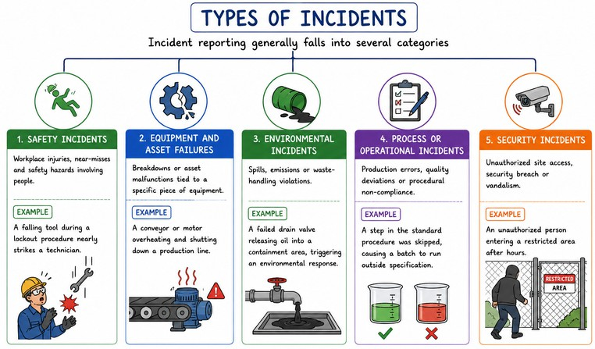
INCIDENT
An incident is an unplanned event or occurrence that
disrupts causes quality,
normal operations, a drop in service
or leads to an
unexpected situation. It can
range from annoyance to emergency.
a minor
a major

Slide 30
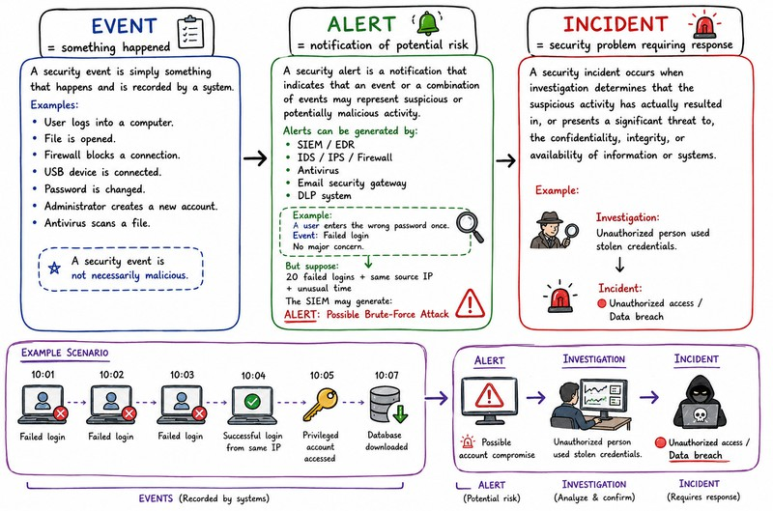

Slide 31
Security Event
Any observable occurrence or change of state in a system, network, or device.
Nature: Mostly routine and often completely benign. It is simply an action being logged.
Examples: A user successfully logging into an email account, a firewall blocking a standard packet, or a device turning on.
A security event is a change in the normal behavior of a given system, process, environment or workflow.
In other words: when something happens, it’s an event.
An event can be either positive or negative. An average organization experiences thousands of events every day. These cybersecurity events can be as small as an email, or as large as an update to your firewalls.
Examples of a cybersecurity event:
An employee flags a suspicious email.
Someone downloads software (authorized or unauthorized) to a company device. A security lapse occurs due to a server outage.

Slide 32
Security Alert
A notification or warning generated by a security tool when an event or pattern matches predefined suspicious rules or thresholds.
Nature: Acts as a raised flag indicating that something might be wrong and requires human or automated review.
Examples: Multiple failed login attempts in one minute, an unknown device connecting to the network, or a potential malware signature detected on an endpoint.
An alert is a notification of a cybersecurity event. (Or, sometimes, a series of events.) You can work with your security provider to determine which types of events you want to monitor with alerts. Depending on your Security Information and Event Management (SIEM) software and support, you can send alerts to any relevant parties who need to take action.

Slide 33
Security Incident
A confirmed security event (or series of alerts) that actively compromises the confidentiality, integrity, or availability of data, systems, or networks.
Nature: A verified threat that has harmful impact and triggers formal incident response procedures to investigate, contain, and fix.
Examples: A successful ransomware execution, an actual data breach leaking user records, or a confirmed unauthorized login compromising an administrator account
A security incident is a change in a system that negatively impacts the organization, municipality, or business. For example, an incident might take place when a cyber attack occurs.
Note: an attempted breach is not the same as an actual breach. This means, if you count breach attempts as incidents, you may have more incidents than what actually occurred. This mistake creates white noise and alarm fatigue. It also makes the collected incident data less valuable.
Examples of a cybersecurity incident:
An employee replies to a phishing email, divulging confidential information. Equipment with stored sensitive data is stolen.
A password is compromised through a brute force attack on your system.

Slide 34
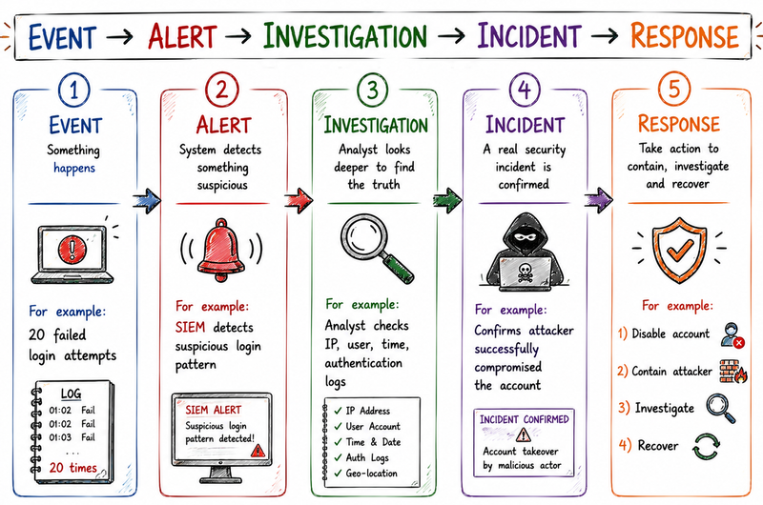

Slide 35
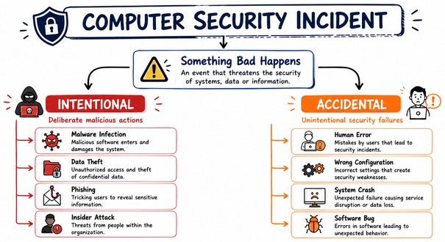
SECURITY INCIDENTS
A security incident, or security event, is any digital or physical breach that threatens the confidentiality, integrity or availability of an organization’s information systems or sensitive data.
Security incidents can range from intentional cyberattacks by hackers or unauthorized users, to unintentional violations of IT security policy by legitimate authorized users.
A cyber incident refers to any unauthorised attempt to access, disrupt or compromise systems, networks or data.
A computer incident is any action or actitvity, accidental or deliberate that compromises the Confidentiality, Integrity and Availablity of data and information.
Involving actual or potential compromise like malware, unauthorized access, or data breaches, requiring a structured incident response to detect, analyze, contain, and recover from the attack, ultimately learning to prevent future occurrences.

Slide 36
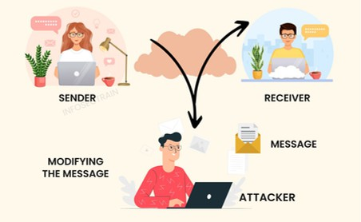
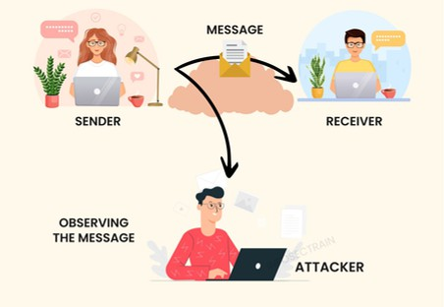
ATTACKS
ATTACKS
ACTIVE ATTACKS
PASSIVE ATTACKS

Slide 37
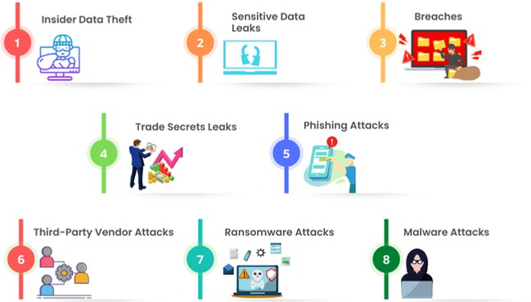
TYPES OF COMPUTER SECURITY INCIDENTS

Slide 38
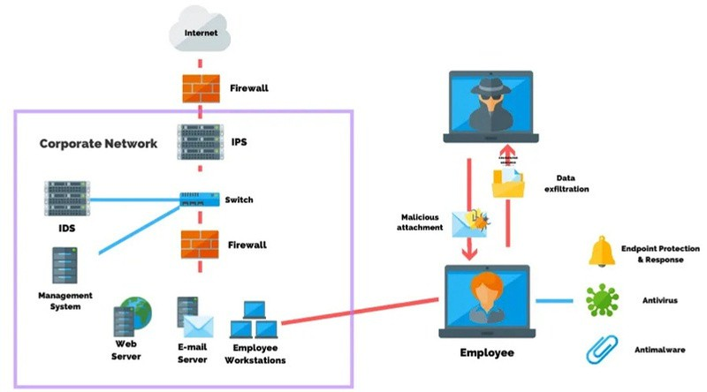
SOCIAL ENGINEERING
Social engineering forces people to click links, extend access, or provide login credentials by manipulating their psychology.
Attackers might use real names, places, dates, and other details (stolen from social media) to appear legitimate and trustworthy, among countless other ways these security incidents occur.
Manipulative tactics used by attackers to deceive and convince individuals to divulge confidential information or perform actions that compromise security.

Slide 39
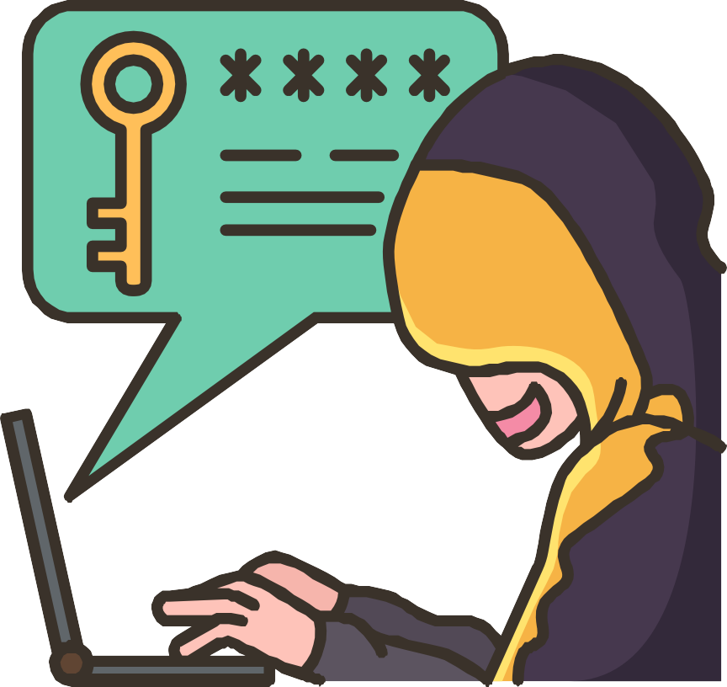
MALWARE
Malware inflicts damage by hiding malicious code inside software. One example is ransomware, where the code either steals or encrypts data, then hackers demand payment to restore access to the data or keep it from being released.
Malware refers to any malicious software that’s designed to harm a computer system or exfiltrate data. It comes in many different forms including viruses, ransomware, spyware, and trojan horses. Bad actors install malware by taking advantage of hardware and software vulnerabilities or by convincing an employee to do it using a social engineering technique.

Slide 40

RANSOMWARE
In a ransomware attack, bad actors use malware to encrypt critical data and systems and then threaten to make the data public or destroy it if the victim doesn’t pay a ransom.
With Ransomware, the victim’s system is held hostage until they agree to pay a ransom to the attacker.
After the payment has been sent, the attacker then provides instructions regarding how the target can regain control of their computer.
The name "ransomware” is appropriate because the malware demands a ransom from the victim.
Malware is one of the oldest and most enduring causes of security incidents, and ransomware has been one of the most aggressive and expensive causes in recent years.

Slide 41

TROJAN HORSE
A Trojan horse attack uses a malicious program that is hidden inside a seemingly legitimate one.
When the user executes the presumably innocent program, the malware inside the Trojan can be used to open a backdoor into the system through which hackers can penetrate the computer or network.
This threat gets its name from the story of the Greek soldiers who hid inside a horse to infiltrate the city of Troy and win the war. Once the “gift” was accepted and brought within the gates of Troy, the Greek soldiers jumped out and attacked. In a similar way, an unsuspecting user may welcome an innocent-looking application into their system only to usher in a hidden threat.

Slide 42

PASSWORD ATTACKS
Password attacks often precede information security events since passwords and other login credentials are the fastest and easiest way to gain unauthorized access to systems and data.
Ways to get someone’s password include stealing it through phishing attacks, credential stuffing, and brute force hackers put tremendous energy and ingenuity into this effort.

Slide 43
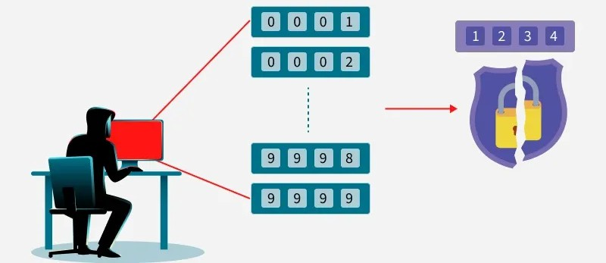
BRUTE-FORCE ATTACKS
Brute force is a method where attackers try all possible passwords until the right one is found. It doesn’t exploit software flaws but relies on trial-and-error testing.
The attacker simply tries to guess by trying different combinations of the login credentials of someone with access to the target system. Once they get it right, they are in.
The attack may use common wordlists (dictionary) or full character sets. Though slow, weak passwords can be cracked quickly with powerful systems.
To prevent brute-force attacks, have lock-out policies in place as part of your authorization security architecture. After a certain number of attempts, the user attempting to enter the credentials gets locked out. This typically involves “freezing” the account so even if someone else tries from a different device with a different IP address, they cannot bypass the lockout.

Slide 44
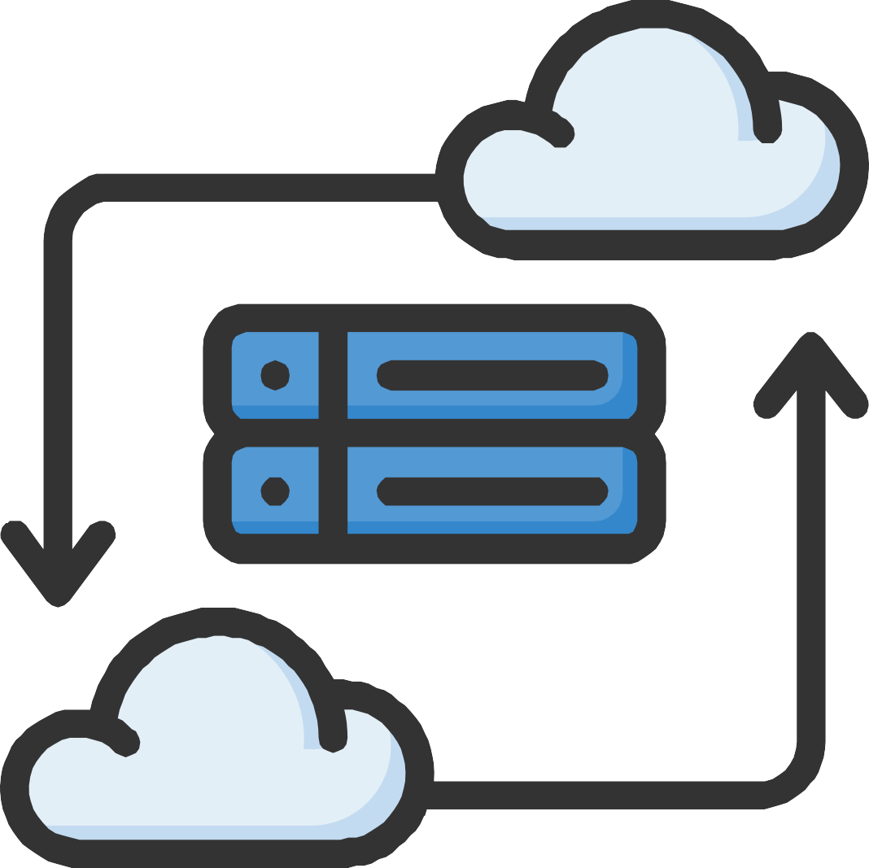
CREDENTIAL STUFFING
Credentials stuffing happens when attackers take databases of known login credentials and use them on other sites and services, hoping to find reused credentials.
Frequent data breaches give attackers access to ever-larger amounts of compromised credentials they can weaponize, and the rise of AI makes it easier than ever to stuff credentials at scale or maximize success rates.

Slide 45

BUSINESS EMAIL COMPROMISE (BEC)
A Business Email Compromise (BEC) attack is a specialized social engineering cybercrime where an attacker poses as a trusted source such as a CEO, vendor, or lawyer to trick employees into wiring money or sharing sensitive company data. These attacks rely on psychological manipulation rather than malicious software links.
Considered a subset of social engineering, attacks known as business email compromise target the inbox with messages that appear to be from superiors, collaborators, and vendors asking for money, access, or data using convincing language mixed with legitimate information.

Slide 46

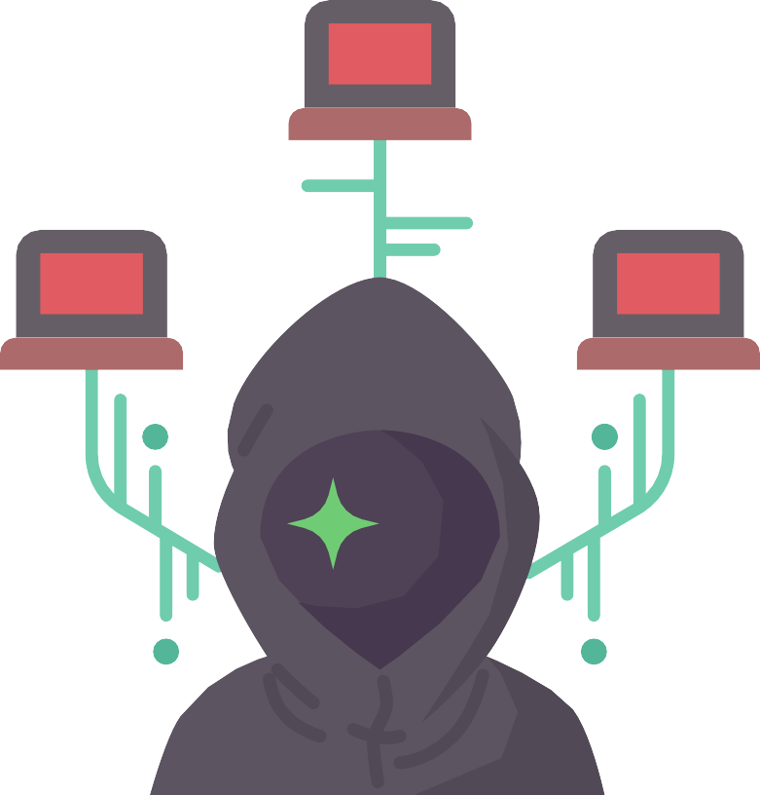
SUPPLY CHAIN ATTACKS
In supply chain attacks, malicious actors gain access to a target by way of a third-party.
They will breach one company, then use the trusted relationships and integrated technology that company has with vendors, business partners, and customers to breach other companies, often without raising red flags or encountering many obstacles.

Slide 47
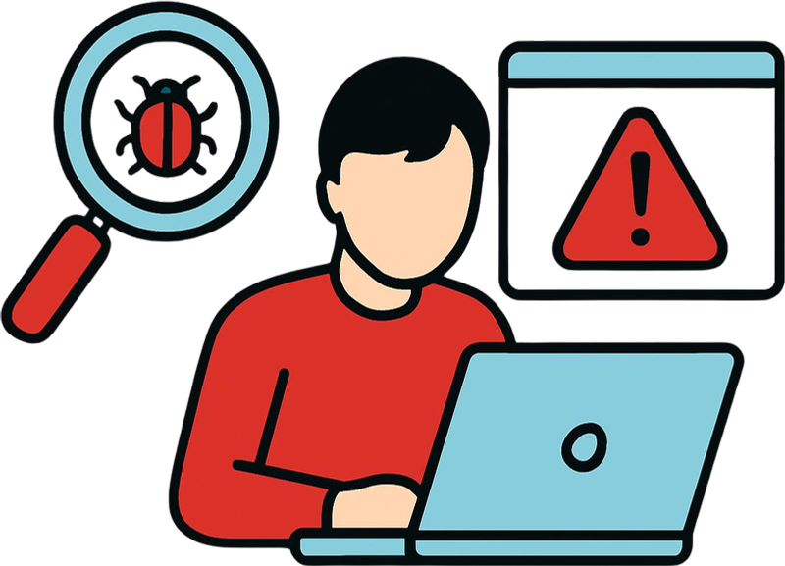
INSIDER THREATS
Insider threats come from employees, contractors, of vendors working “inside” the organization, where they have access and permissions that can be abused, whether accidentally or intentionally.
Although most attacks are conducted by people outside an organization, security teams also need to be on the lookout for insider threats.
Employees and other people who legitimately have access to restricted resources may inadvertently or in some cases intentionally leak sensitive data.

Slide 48
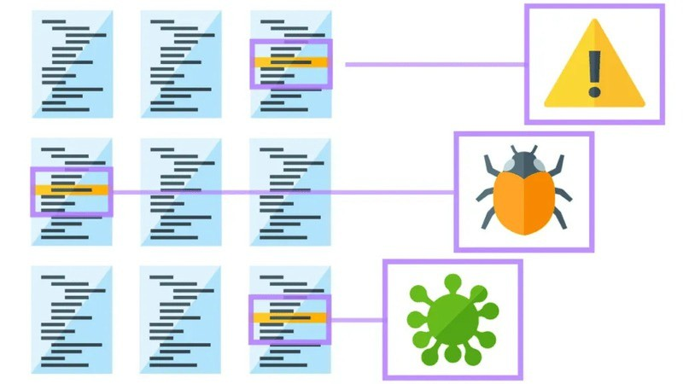
WEB APPLICATION ATTACKS
When attackers find vulnerabilities or implementation issues in web applications, they can attack those applications to steal sensitive information, gain unauthorized system access, or take critical applications offline.
Incidents like these have become more damaging as companies rely on larger numbers of web applications to enable remote work.
Examples: SQL Injection, Cross-Site Scripting (XSS), Command Injection, File Inclusion, Broken Authentication, Broken Access Control, Malicious File Upload, Session attacks

Slide 49
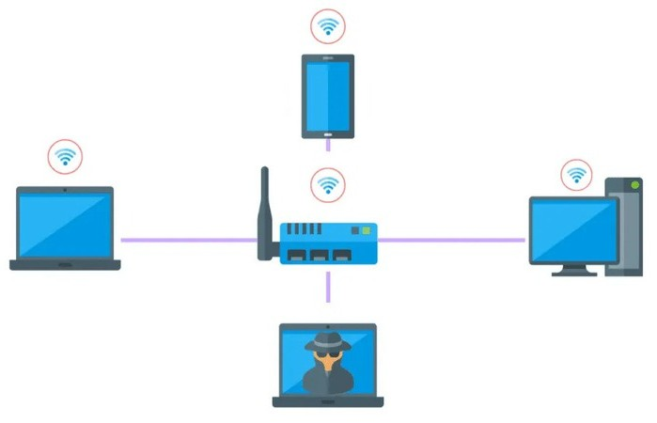
IOT ATTACKS
Internet-connected devices (known as IoT devices) are ubiquitous in the digital world, and they are developed and deployed so quickly that many have inadequate or minimal cybersecurity built in.
From eavesdropping on video conferences to taking control of a moving car, IoT attacks can have many alarming effects, especially as they proliferate.

Slide 50
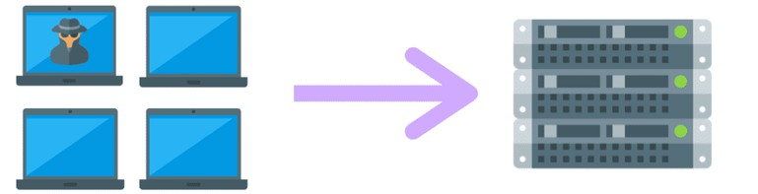

DENIAL-OF-SERVICE (DOS) AND DISTRIBUTED DENIAL-OF-SERVICE (DDOS) ATTACKS
In both these types of attacks, servers are flooded with traffic until they go offline, taking critical apps, services, and data with them.
Denial of services attacks send the traffic from one source while the distributed variety sends it from multiple sources.
Some best practices to keep from getting overwhelmed by malicious traffic include rate limiting, network segmentation, and continuous monitoring plus immediate response capabilities if an attack occurs.
In a denial-of-service attack (DDoS attack), a threat actor overwhelms a network or system with traffic until it slows or crashes. Typically, attackers target high-profile companies like banks or governments with the goal of costing them time and money, but organizations of all sizes can be victims of this type of attack.

Slide 51
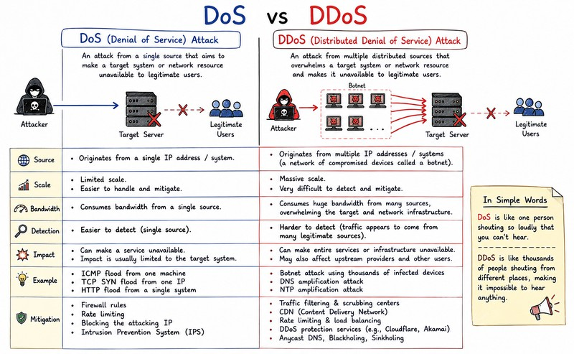

Slide 52
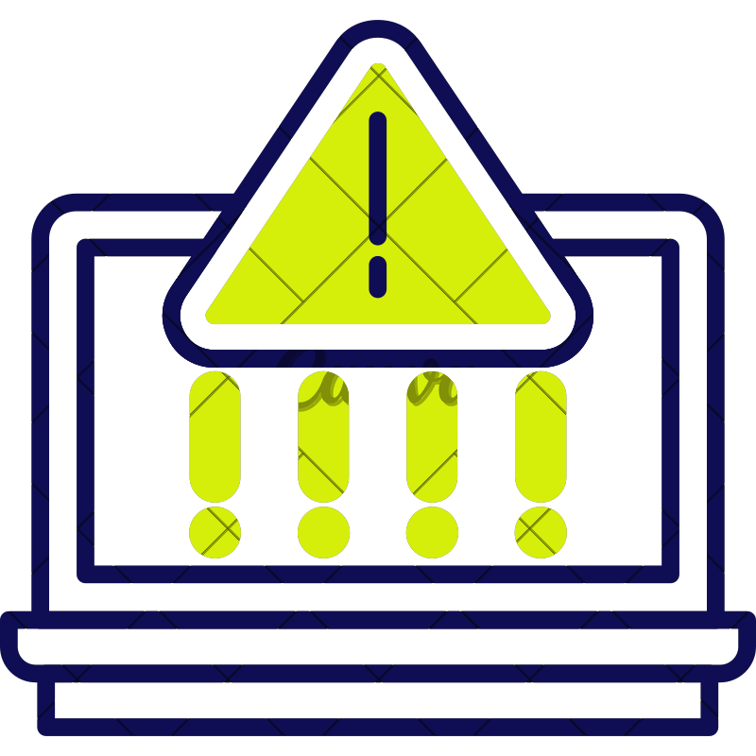
ADVANCED PERSISTENT THREATS (APTS)
Advanced Persistent Threats (APTs) are stealthy, long-term cyberattacks where skilled attackers (often state-sponsored) infiltrate a network to steal sensitive data, conduct espionage, or sabotage systems, remaining undetected for extended periods by using custom tools, social engineering, and adapting tactics to bypass security.
They differ from typical attacks by their patience, targeted nature, high resources, and methodical approach, aiming for deep network presence to achieve goals like intellectual property theft or disruption over months or years.

Slide 53
Advanced: Involves sophisticated techniques, custom malware, zero-day exploits, and significant resources.
Persistent: Focuses on long-term remaining hidden for months or
access, years,
continuously exfiltrating data or monitoring.
Targeted: Aims at specific high-value
large
organizations (governments,
corporations) for specific objectives, not just quick financial gain.
Stealthy:
Mimics normal traffic, uses
legitimate credentials, deletes logs, and employs anti-forensics to evade detection.

Slide 54
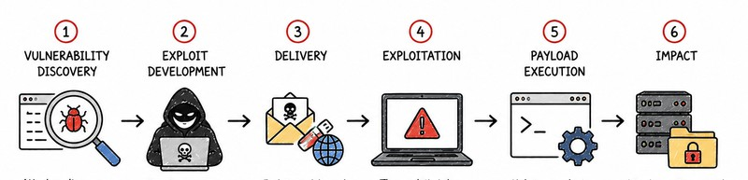
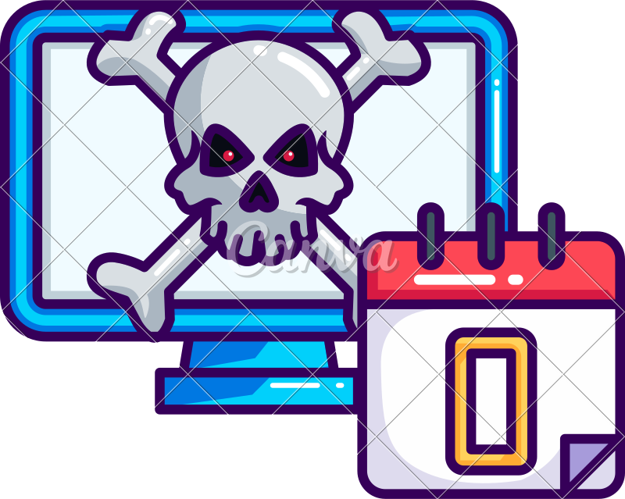
ZERO-DAY EXPLOITS
A zero day exploit is a vulnerability that is known by attackers but not by vendors, meaning there is no existing fix for the flaw and likely insufficient cybersecurity.
A zero-day attack takes place when hackers exploit the flaw before developers have a chance to address it.
These exploits are especially dangerous because they don’t set off alarm bells when compromised, nor is there an easy way to prevent the problem.

Slide 55
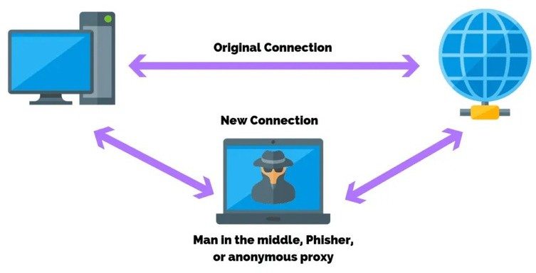
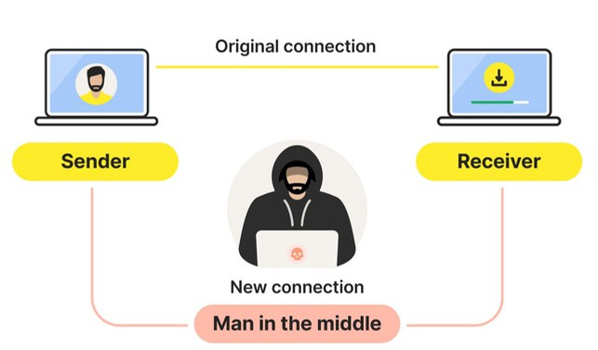
MAN-IN-THE-MIDDLE (MITM) ATTACKS
As the name implies, man-in-the-middle
attacks position
themselves between two ends of a communication channel and steal or even alter data traveling in-between.
In one simple example, attackers make malicious Wi-Fi hotspots available in a public place, wait for someone to connect, then steal data throughout their session, including login credentials.
Another method that cybercriminals use to steal personal data is to insert themselves in the middle of an online conversation between people who believe they are communicating privately.
By intercepting messages and copying them or changing them before sending them to the intended recipient, they try to manipulate one of the participants into giving them valuable data.

Slide 56

SESSION HIJACKING
Session hijacking is one of multiple types of MITM attacks. The attacker takes over a session between a client and the server.
The computer being used in the attack substitutes its Internet Protocol (IP) address for that of the client computer, and the server continues the session without suspecting it is communicating with the attacker instead of the client.
This kind of attack is effective because the server uses the client's IP address to verify its identity. If the attacker's IP address is inserted partway through the session, the server may not suspect a breach because it is already engaged in a trusted connection.

Slide 57
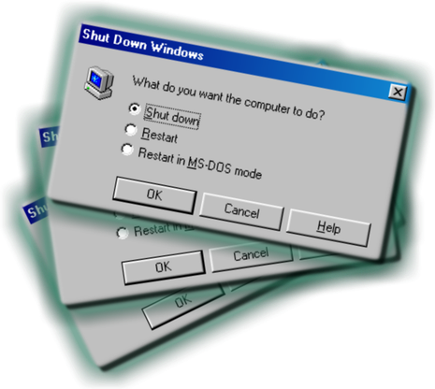


PHISHING
Phishing is a cyberattack where scammers impersonate trusted entities (like banks or companies) in emails, texts, or calls to trick people into revealing sensitive data (passwords, credit card numbers) or installing malware, often by directing them to fake websites that look real, with the goal of stealing money, identities, or gaining network access.
It's a form of social engineering, exploiting human trust rather than just tech flaws, and can range from broad campaigns to highly targeted "spear phishing" attacks.
A typical phishing attack tries to persuade recipients to download malware or provide their password. These attacks exploit people’s trust and deploy psychological techniques like fear to get people to act.

Slide 58

SPEAR-PHISHING ATTACKS
Spear phishing refers to a specific type of targeted phishing attack.
The attacker takes the time to research their intended targets and then write messages the target is likely to find personally relevant.
These types of attacks are aptly called “spear” phishing because of the way the attacker hones in on one specific target.
The message will seem legitimate, which is why it can be difficult to spot a spear-phishing attack.

Slide 59

WHALING
A whale-phishing attack is so-named because it goes after the “big fish” or whales of an organization, which typically include those in the C-suite or others in charge of the organization.
These individuals are likely to possess information that can be valuable to attackers, such as proprietary information about the business or its operations.
If a targeted “whale” downloads ransomware, they are more likely to pay the ransom to prevent news of the successful attack from getting out and damaging their reputation or that of the organization.
Whale-phishing attacks can be prevented by taking the same kinds of precautions to avoid phishing attacks, such as carefully examining emails and the attachments and links that come with them, keeping an eye out for suspicious destinations or parameters.

Slide 60
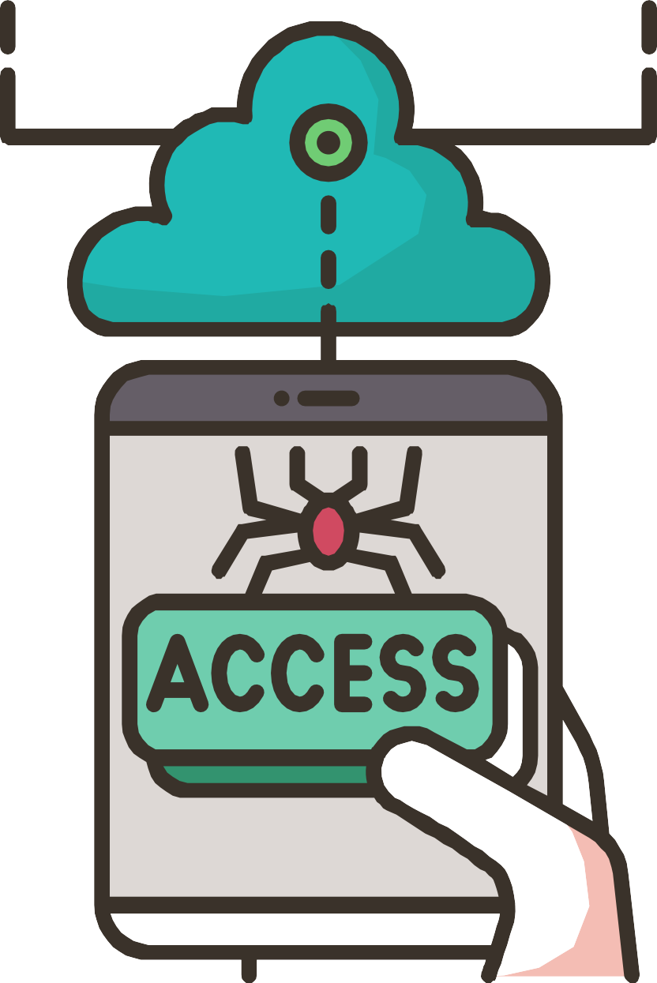
UNAUTHORIZED ACCESS AND DATA BREACHES
Unauthorized access is gaining entry to systems or data without permission.
While a data breach is a specific incident where this access leads to the exposure or theft of sensitive information, often resulting from hacking, malware, phishing, insider threats, or human error, causing severe financial, reputational, and legal damage.
A lot of security breaches start with stolen account credentials. Whether bad actors acquire passwords via a phishing campaign or by guessing a common password, once they gain access to a system they can install malware, do network reconnaissance, or escalate their privileges to allow them access to more sensitive systems and data.
When someone gains unauthorized access to a system, network, or data, often by exploiting vulnerabilities or using stolen credentials.

Slide 61

SQL INJECTION ATTACKS
Structured Query Language (SQL) injection is a common method of taking advantage of websites that depend on databases to serve their users.
Clients are computers that get information from servers, and an SQL attack uses an SQL query sent from the client to a database on the server.
The command is inserted, or “injected”, into a data plane in place of something else that normally goes there, such as a password or login. The server that holds the database then runs the command and the system is penetrated.

Slide 62
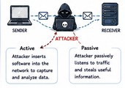
EAVESDROPPING
Eavesdropping attacks involve the bad actor intercepting traffic as it is sent through the network. In this way, an attacker can collect usernames, passwords, and other confidential information like credit cards. Eavesdropping can be active or passive.
With active eavesdropping, the hacker inserts a piece of software within the network traffic path to collect information that the hacker analyzes for useful data.
Passive eavesdropping attacks are different in that the hacker “listens in,” or eavesdrops, on the transmissions, looking for useful data they can steal.

Slide 63

XSS ATTACKS
With XSS, or cross-site scripting, the attacker transmits malicious scripts using clickable content that gets sent to the target’s browser. When the victim clicks on the content, the script is executed.
Because the user has already logged into a web application’s session, what they enter is seen as legitimate by the web application.
However, the script executed has been altered by the attacker, resulting in an unintended action being taken by the “user.”

Slide 64

DNS SPOOFING
With Domain Name System (DNS) spoofing, a hacker alters DNS records to send traffic to a fake or “spoofed” website.
Once on the fraudulent site, the victim may enter sensitive information that can be used or sold by the hacker.
The hacker may also construct a poor-quality site with derogatory or inflammatory content to make a competitor company look bad.
In a DNS spoofing attack, the attacker takes advantage of the fact that the user thinks the site they are visiting is legitimate.

Slide 65
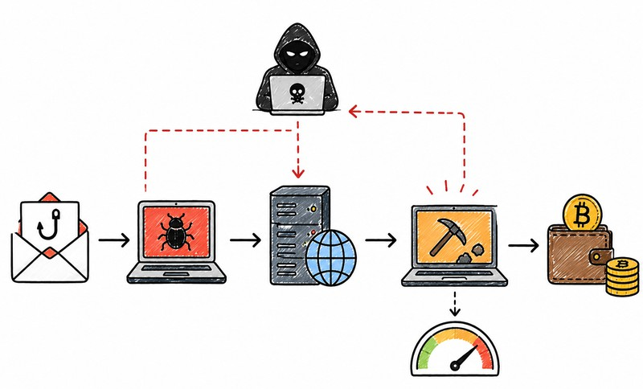
CRYPTOJACKING
Cryptojacking occurs when an attacker secretly uses another organization's computing resources to mine cryptocurrency.
Indicators
High CPU usage
High power consumption Slow systems
Unknown mining processes Connections to mining pools

Slide 66
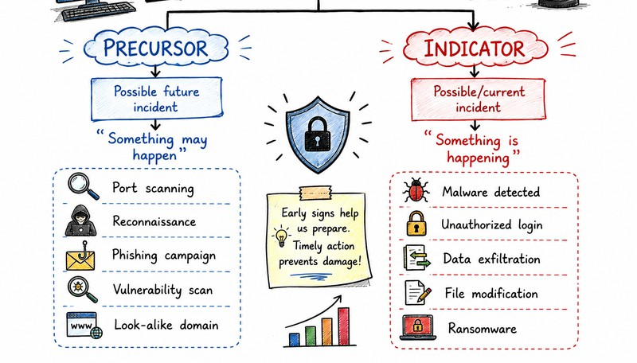
SIGNS OF AN INCIDENT

Slide 67
What is a Precursor?
A precursor is an observable sign that suggests an incident may occur in the future. Catching a precursor allows organizations to take preventive measures before any actual damage happens.
Threat announcements: A hacker group or rival entity publicly states they will target your organization.
Vulnerability scanner activity: Web server logs show someone probing your network with a scanner.
New exploit disclosures: A newly published exploit targets a specific service or server version you currently run.
Transient port scans: Evidence of subtle network reconnaissance testing your firewall boundaries.

Slide 68
A precursor is an observable event or condition that suggests that an attacker may be preparing for an attack. It does not necessarily mean that an incident has occurred.
Examples:
Repeated vulnerability scanning of an organization's public IP addresses Port scanning against servers
Phishing emails sent to employees Registration of a look-alike domain
An attacker researching employees on social media Attempts to identify VPN or remote-access services
Threat intelligence reporting that a particular organization is being targeted Discovery of a new vulnerability affecting the organization's software Suspicious reconnaissance activity
Example scenario:
An organization's firewall detects repeated port scans from an external IP address.
This is a precursor because the attacker may simply be performing reconnaissance before attempting exploitation.

Slide 69
What is an Indicator?
An indicator is a sign that an incident may have occurred or is currently in progress. It points to active or completed events requiring immediate triage.
Antivirus alerts: Security software flags an active malware infection on a host machine.
Failed login spikes: An application log records multiple failed authentication attempts from an unfamiliar remote location.
Traffic anomalies: Network administrators notice sudden, unexplained deviations from normal data flow patterns.
Suspicious files: System files or directories appear with unusual or hidden characters

Slide 70
An indicator is an observable sign that provides evidence that a security incident may be happening or has already happened. Indicators are generally stronger evidence than precursors.
Examples:
Malware detected by antivirus/EDR Unauthorized login
Multiple failed login attempts followed by a successful login Unexpected administrator account creation
Files being encrypted unexpectedly Unusual outbound network traffic
Data being transferred to an unknown external IP Website defacement
Unauthorized modification of system files Suspicious PowerShell commands Ransomware note appearing on a computer
User reports that files have suddenly disappeared or changed Logs showing successful exploitation of a vulnerability
Example scenario:
EDR detects a malicious executable, and firewall logs show that the infected computer is communicating with a known malicious IP address.
These are indicators because there is evidence that compromise may have already occurred.

Slide 71
SIGNS OF AN INCIDENT
Unexpected system behavior: Unusual or unexpected system behavior can often indicate a security event. This could include systems running more slowly than usual, crashing, or restarting frequently. Unexpected changes in the configuration of systems, or new user accounts being created without reason can also be a sign.
Anomalies in network traffic: A sudden increase in network activity, particularly during non-business hours, can indicate a security incident. This could be a sign of a data breach, with large amounts of data being transferred out of the network.
Unauthorized access or account activity: If there are signs of access or activity on an account that the account owner did not initiate, this could indicate a security incident. This might include unfamiliar transactions, or changes to account settings or credentials.
Unexpected software or files: The presence of unknown software, files, or processes on a system can suggest a security incident. This could be malware that has been installed on the system.

Slide 72
Altered or deleted files: If files are changed or deleted without reason, this could be a sign of a security incident. Similarly, if there are unauthorized changes to file permissions, this could indicate a security issue.
Unexpected communications: Unexpected or unusual emails, particularly those with attachments or links, can be a sign of a phishing attempt, which is a common security event or incident if successful.
Unusual resource usage: A sudden spike in CPU usage, disk activity, or network bandwidth could indicate a security incident, as many types of malware are resource-intensive. Beyond malware, CPU usage can also indicate some form of blockchain mining operation, or a server running some form of unsanctioned web programming.
Unusual user behavior: If a user starts accessing files or systems they don’t typically use, or at odd hours, it could be a sign of a compromised account or disgruntlement.
Ransom or Extortion Messages: Any communication demanding payment to restore access or prevent data release should trigger a full incident response procedure.

Slide 73
MAJOR CATEGORIES OF INCIDENTS
In Incident Response Management (IRM), an incident is an event that disrupts normal operations, affects the availability or performance of IT services, compromises security, or causes loss, corruption, or unauthorized access to information.
Incidents can be broadly classified into the following major categories:

Slide 74
1. Infrastructure Failures
Infrastructure incidents involve failures or malfunctioning of the physical and underlying IT infrastructure required to operate information systems.
Common examples
Server hardware failure Hard-disk or SSD failure RAM or processor failure Power supply failure
UPS failure Overheating of servers
Data-center cooling failure Storage-system failure Hardware component malfunction Physical damage to IT equipment
Example
A university's main server suddenly shuts down because of a failed power supply unit. Incident category: Infrastructure failure
Impact: Online services become unavailable Affected property: Availability

Slide 75
2. Application Errors and Failures
Application incidents occur when software applications fail, behave incorrectly, become unavailable, or produce unexpected results.
Common examples Application crash Software bugs
Database application failure ERP/CRM failure
Web application errors Incorrect software configuration Failed software update
Application performance degradation API failure
Dependency or service failure
Example
The university's student management system crashes after a software update, preventing students from registering for courses.
Incident category: Application failure Impact: Academic services are disrupted
Affected property: Availability and potentially Integrity

Slide 76
3. Security Incidents / Security Breaches
Security incidents involve events that threaten or compromise the confidentiality, integrity, or availability of information systems and data. This is one of the most important categories in cybersecurity-focused IRM.
Common examples Unauthorized access Malware infection Ransomware Phishing
Credential compromise Brute-force attacks Data theft
Privilege escalation
Incident category: Security incident Attack method: Phishing / credential theft Impact: Unauthorized access
SQL injection Website defacement
Denial-of-Service (DoS/DDoS) Account compromise
Insider misuse
Example
Affected property: Confidentiality and Integrity
An employee clicks a phishing link and unknowingly provides their corporate password. The attacker subsequently logs into the employee's account.

Slide 77
4. Data Integrity and Data Loss Incidents
These incidents involve loss, corruption, unauthorized modification, accidental deletion, or destruction of data. The incident may be caused by technical failure, human error, malicious activity, or software problems.
Common examples
Accidental deletion of files Database corruption Storage failure
Data modification Incorrect database update File-system corruption Loss of backup data
Unauthorized alteration of records Data synchronization errors Accidental overwriting of information
Example
An employee accidentally deletes a database containing important student records and the organization discovers that the latest backup is also incomplete.
Incident category: Data loss/integrity incident Impact: Loss of critical information
Affected property: Integrity and Availability

Slide 78
5. Network Outages and Network Failures
Network incidents involve the loss, degradation, communication services.
Common examples
Internet outage
LAN failure / WAN failure High network latency Packet loss
DNS failure DHCP failure
Router failure / Switch failure / Firewall failure VPN failure
Wireless network failure Network congestion
or disruption of network connectivity and
Example
A university's DHCP server fails, preventing computers from obtaining IP addresses. Students and staff are unable to access internal network resources.
Incident category: Network failure Impact: Loss of network connectivity Affected property: Availability

Slide 79
WHAT IS
INCIDENT RESPONSE ?
Incident response is the strategic & organized response an organization uses following a cyberattack.
The response is executed according to planned procedures that seek to limit damage and repair breached vulnerabilities in systems.
Incident response is an organization's structured process for detecting, managing, and recovering from cybersecurity breaches and threats.
It minimizes system downtime, data loss, and reputational damage by following a standardized framework typically consisting of preparation, identification, containment, eradication, recovery, and lessons learned

Slide 80
NEED FOR INCIDENT RESPONSE
The need for incident response (IR), requiring a systematic approach to minimize damage, downtime, and financial loss by quickly identifying, containing, and eradicating threats.
It protects sensitive data, maintains business continuity, preserves customer trust, ensures regulatory compliance, and builds long-term resilience by learning from incidents to improve security posture.
Without IR, breaches escalate, leading to severe operational disruption, reputational harm, and significant recovery costs.
A cybersecurity incident can cost organizations millions in discovery, containment, and the legal aftermath of losing records to an attacker. Effective incident management reduces both the time an attacker persists on the network and the number of future incidents.
In addition to minimizing damages, costs, and recovery time associated with a cyber-attack, incident response is vital in ensuring business continuity in the wake of a security crisis, such as a data breach.

Slide 81
Minimize Damage & Downtime: Rapid containment stops attacks from spreading, reducing operational disruptions and financial losses from ransomware, data theft, or system shutdowns.
Protect Data & Assets: Identifies and secures sensitive information (PII, PHI, trade secrets) from exfiltration or misuse.
Preserve Reputation & Trust: Shows stakeholders (customers, partners) that the organization takes security seriously, fostering loyalty.
Ensure Compliance: Helps meet legal and regulatory requirements (GDPR, HIPAA, PCI DSS) by providing a structured response to data breaches.
Improve Security Posture: Analysis of incidents reveals vulnerabilities, allowing for root cause elimination and stronger future defenses.
Maintain Business Continuity: Restores critical systems and services quickly, keeping essential operations running.
Reduce Costs: Prevents escalating costs associated with prolonged outages, regulatory fines, legal fees, and reputational damage.

Slide 82
GOALS AND PURPOSE OF INCIDENT RESPONSE
Incident response (IR) helps to minimize damage, reduce recovery time/cost, and restore normal operations after a security event, protecting assets, data, and reputation.
Its purpose is to provide a structured, systematic approach (preparation, detection, containment, eradication, recovery, lessons learned) to handle threats efficiently, ensuring business continuity and building resilience against future attacks.
The core goal of incident response is to systematically manage and neutralize security breaches to minimize damage, reduce recovery time, and prevent future attacks. It ensures business continuity and protects an organization's critical assets, reputation, and bottom line.
Primary Goals: Minimize Impact Rapid Recovery Business Continuity Cost Reduction
Reputation Protection

Slide 83
The primary purposes and objectives of a structured incident response include:
Mitigating Damage: Rapidly stopping an active threat (such as isolating infected systems) to prevent the compromise from spreading across the network.
Ensuring Business Continuity: Restoring compromised systems and resuming normal operations safely and efficiently.
Identifying Root Causes: Conducting forensic analysis to understand how the incident occurred, which prevents attackers from exploiting the same vulnerabilities twice.
Meeting Compliance: Satisfying
legal, regulatory, and industry reporting
requirements (such as GDPR, PCI DSS, or HIPAA) to avoid hefty fines.

Slide 84
CHALLENGES IN INCIDENT RESPONSE
1. Communication Breakdowns
During an incident, multiple teams may need to work together, such as: SOC
Incident Response Team Network Team
System Administrators Digital Forensics Team Management
Legal and Compliance External vendors
If these teams communicate through separate channels or do not share information properly, fragmented and conflicting information can arise.
Example: The SOC identifies a suspected attack, but the network team is not informed immediately. As a result, the malicious connection remains active for another 30 minutes.
IRM lesson: Establish a central communication channel and clear reporting hierarchy.

Slide 85
2. Outdated or Missing Incident Response Plans
An organization may have an incident response plan, but if it is outdated, incomplete, or not tested, it may not be useful during a real incident.
Problems include:
No clearly defined responsibilities Missing escalation procedures Outdated contact information
No documented containment procedures Unclear decision-making authority
Failure to account for new technologies such as cloud and remote work
Example: A ransomware attack occurs, but employees do not know who has authority to isolate the affected server.
IRM lesson: Maintain, test, and regularly update Incident Response Plans, SOPs, and playbooks.

Slide 86
3. Alert Fatigue and Information Overload
Modern organizations generate huge numbers of alerts from: SIEM
IDS/IPS EDR
Firewalls Antivirus
Email security systems Cloud platforms Authentication systems
Security analysts may receive thousands of alerts, making it difficult to distinguish a critical incident from routine or false-positive alerts.
Example: 5,000 alerts → 4,800 low priority → 190 medium priority → 10 high priority If analysts are overwhelmed, an important alert may be missed.
IRM lesson: Use alert prioritization, correlation, threat intelligence, and automation.

Slide 87
4. Lack of Real-Time Visibility
Incident managers need to know: What happened?
Which systems are affected? Who is investigating?
What containment actions have been completed? What remains affected?
Has the attacker been removed? When will services be restored?
If information is recorded manually in spreadsheets, emails, or multiple chat channels, obtaining an accurate real-time picture becomes difficult.
Example: Management believes that the incident has been contained, while the SOC is still investigating active malicious connections.
IRM lesson: Use centralized dashboards, SIEM/SOAR platforms, incident-management systems, and real-time status tracking.

Slide 88
5. Shortage of Skilled Personnel
Incident response often requires specialized knowledge in: Network security
Malware analysis Digital forensics Cloud security Threat hunting Log analysis
System administration Incident coordination
Organizations may not have enough experienced personnel available when a major incident occurs.
Example: A ransomware attack requires forensic analysis, but the organization has only general IT administrators and no trained digital forensics specialist.
IRM lesson: Organizations should develop trained incident response teams, cross-training programs, and external support arrangements.

Slide 89
6. Heavy Manual Workloads
Manual processes can significantly slow down incident response. Examples include:
Manually checking logs Manually isolating systems Manually collecting evidence
Manually creating incident reports Manually notifying stakeholders Manually correlating alerts
This increases the possibility of human error and delays containment.
Example:
Manual process: Alert → Analyst checks → Finds affected IP → Contacts network team→ Network team verifies → Firewall rule created → System isolated
Automated process: Alert → Detection → Correlation → Automated isolation
IRM lesson: Automate repetitive and time-sensitive activities wherever appropriate using SIEM, SOAR, EDR, scripts, and automated workflows.

Slide 90

THANK YOU

